Slide 1
A Formal Access Control Model for SE-Floodlight Controller Abdullah Al-Alaj¹, Ravi Sandhu¹ and Ram Krishnan² ¹Dept. of Computer Science ²Dept. of Electrical and Computer Engineering ^{1,2}Institute for Cyber Security ^{1,2}Center for Security and Privacy Enhanced Cloud Computing (C-SPECC) University of Texas at San Antonio, TX 78249 SDN-NFV Security 2019 Dallas, Texas, USA, March 27, 2019

Slide 2
Introduction
Software Defined Networks (SDN)
Floodlight
SE-Floodlight

Slide 3

OpenFlow
SDN Enabler.

Slide 4
Application Authorization in SDN
App
App
App
App
REST Calls
App
App
App
SDN Controller
OpenFlow
Switch
Switch
Data plane
Switch
Switch

Slide 5
Components of the Formal Access Control Model
Basic components
Apps (A),
Roles (R),
Data Exchange Operations (DXOP),
Types of DXOPs

Slide 6
Apps
Two types:
Local OpenFlow apps
Remote OpenFlow apps
App
App
App
App
REST Calls
App
App
App
SDN Controller
OpenFlow
Switch
Switch
Switch
Switch

Slide 7
Roles in SE-Floodlight
Two main purposes:
App permission authorization
Flow rule conflict resolution.

Slide 8
Data Exchange Operations (DXOP) and Types of DXOPs
Data Exchange Operations
(DXOP)
Operation types
(T)
add
modify
modify_strict
delete
delete_strict
flow rule
‘Flow rule mod’
OFPT_FLOW_MOD
flows
ports
Tables
Queues
etc
queries
for
statistics
‘Switch stats request’
OFPT_STATS_REQUEST

Slide 9
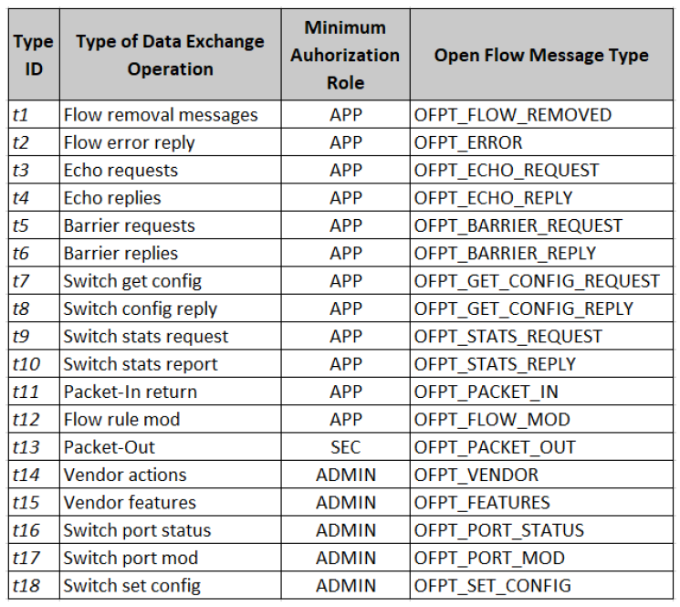
Types of Data Exchange Operations
Porras P. A et al. 2015. Securing the Software Defined Network Control Layer. In NDSS.

Slide 10
Credentials
Authentication & Authorization

Slide 11
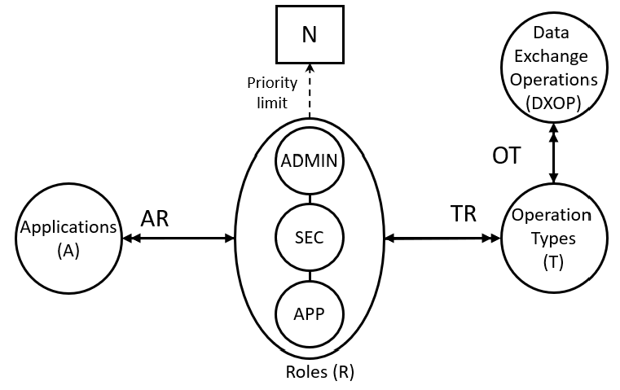
Conceptual Authorization Model

Slide 12
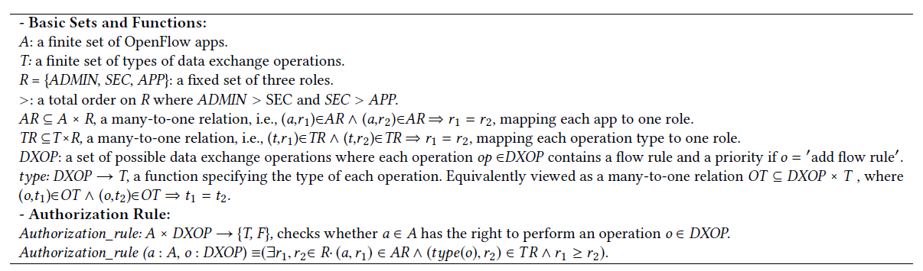
Formal Model Definitions w/o Flow Rule Conflict Resolution
Formal Authorization Model Definitions without Flow Rule Conflict Resolution.

Slide 13
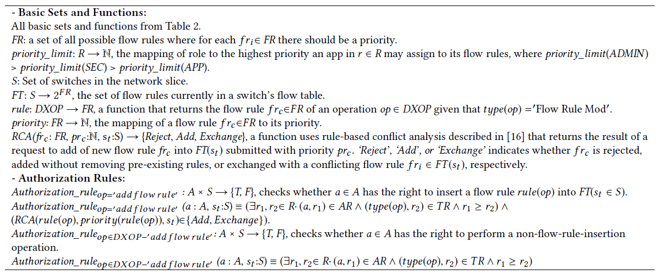
Formal Model Definitions with Flow Rule Conflict Resolution
Formal Model Definitions with Flow Rule Conflict Resolution.

Slide 14
RCA : Add case
New flow rule
e.g., Priority = ?
Add
No Conflict
Existing flow rule
e.g., Priority = ?

Slide 15
RCA : Reject case
Example
New flow rule
e.g., Priority = 50
Reject
Conflict
Existing flow rule
e.g., Priority = 100

Slide 16
RCA : Exchange case
New flow rule
e.g., Priority = 100
Exchange
Conflict
Existing flow rule
e.g., Priority = 50

Slide 17
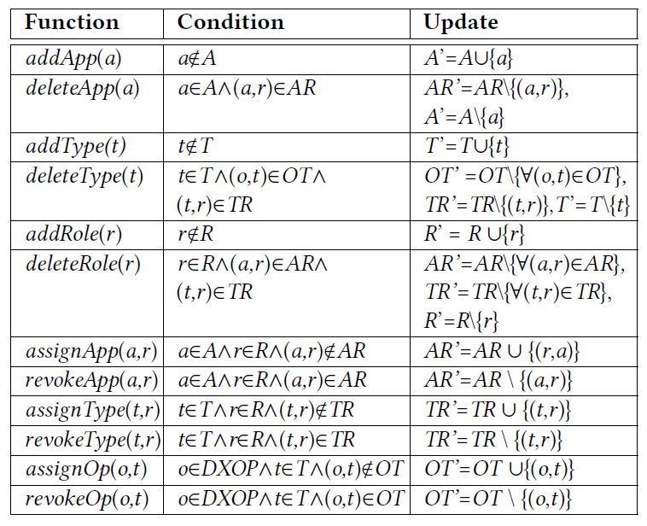
Administrative Model

Slide 18
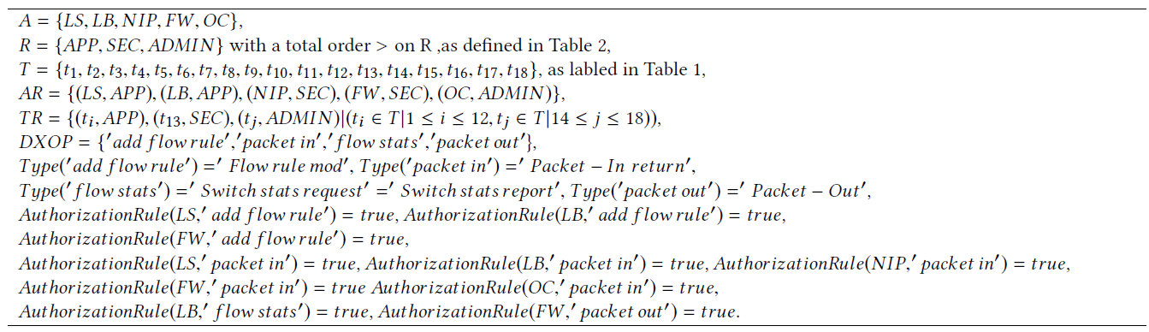
Use Case - Configuration
Five apps

Slide 19
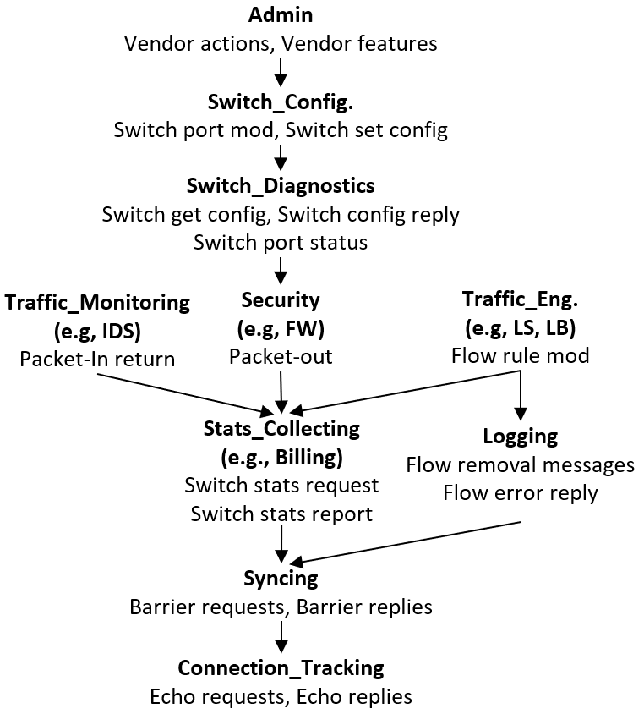
Refined Role Hierarchy

Slide 20
Conclusion and Future Work
A formal authorization model for SDN apps.
An administration model.
A configuration of the formal model in a use case scenario of five apps.
A refined Role hierarchy.
Some future goals:
Extension of SE-Floodlight access control model to cover all controller resources.
An access control model following the NIST RBAC concept.
Fine-grained access control using ABAC within a holistic view to SDN resources.

Slide 21
Thank you!
Questions?
abdullah.al-alaj@utsa.edu

